Slide 1
ADHD-I Analysis Using Logistic Regression
Kim Beswick
San Diego State University

Slide 2
Project Intro: Dataset
Data Sources:
“Non-negative matrix factorization of multimodal MRI, fMRI and phenotypic data reveals differential changes in default mode subnetworks in ADHD,” Published by Anderson A, et al.
fMRI data source: ftp://www.nitrc.org/fcon_1000/htdocs/indi/adhd200/sites/ADHD200_40sub_preprocessed.tgz
730 subjects
105 with ADHD-I
625 controls
1053 features
Phenotypic data
Preprocessed fMRI data

Slide 3
Model: Logistic Regression
Binary classification
Class 1: ADHD-I subjects
Class 0: Controls
Process the y-axis and standardize the inputs to 0 and 1
Use ‘binomial’ distribution when calling glmfit() with x and y inputs, as it performed better than ‘normal’ or ‘poission’ distribution

Slide 4
Strategies for Minimizing the Avg and Std Error:
Testing for increasing cumulative effect, from 1 - N, where N = 1000
Testing of each single feature, 1 - 1053, and track the feature that yields the lowest error
Test groups in features, in sequential sets of 10, from 1 - 500.
Create random permutations of 50 features, iterate N number of times and track the minimum error
Consciously select conspicuous features such as gender or IQ

Slide 5
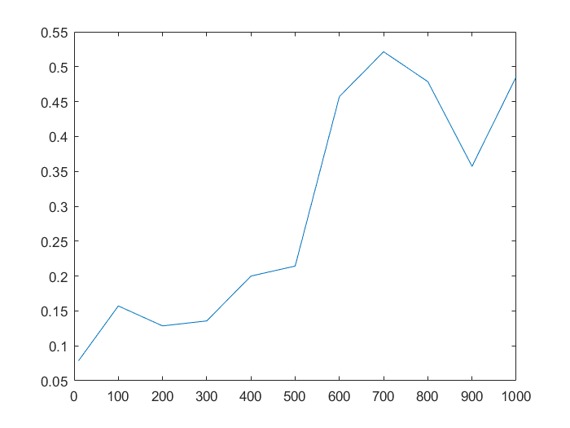
Strategies: Increasing features 1 - N, N = 1000
As number of features increased, so did the average error, getting almost to 50% which is no better than chance.
Not a good strategy

Slide 6
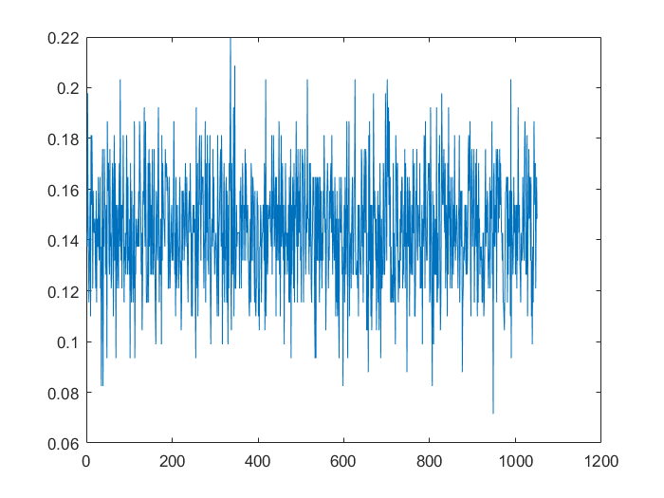
Strategies: Single feature
Each single feature is the only X-axis input
Highest error at .22
Decent avg. error rate for gender and IQ, at .12, .13
Lowest error at .07, which is the posterior ventral DMN toward the end of the dataset.

Slide 7
Strategies: Group Testing
Test groups in features, in sequential sets of 10, from 1 - 1000.
Because there is sequential anatomical data in the spreadsheet, the hypothesis is that certain anatomical data that is grouped together and related to the same brain regions will yield a lower error when tested together
The results dipped below a .1 average error, at the beginning of the set, but did not improve over single-feature testing
Similar result for random permutations of groups of 50 features, which yielded a best error rate of .12 after 50 iterations

Slide 8
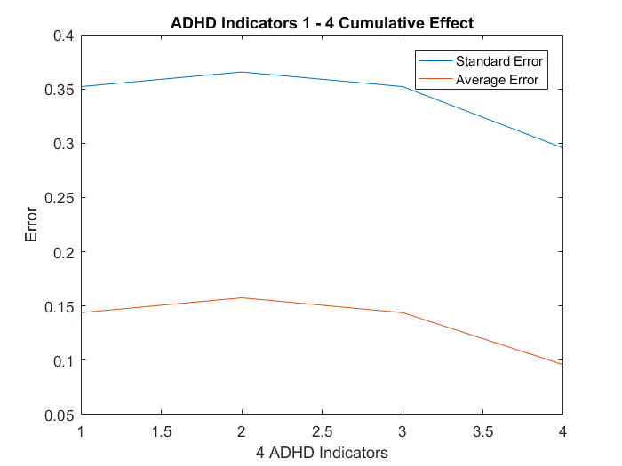
Strategies: ADHD Marker Test
One group of features that did have an improved error as a cumulative effect were the 4 ADHD traits:
1. ADHD.Measure,
2. ADHD.Index
3. Inattentive
4. Hyper.Impulsive
Best combined: .0879 avg. error

Slide 9
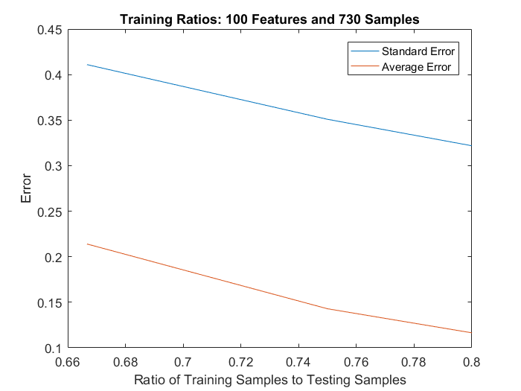
Strategies: Increasing training to testing ratios
Increasing the number of training samples using the first 100 features showed a decreasing error rate

Slide 10
Conclusion
The posterior ventral default mode network, at .07 average error rate, is the best indicator of ADHD-I in the tests run, out of all categories.
The posterior ventral DMN has been correlated with attention in other studies run, including one by Leech R et al. called “Fractionating the default mode network”

Slide 11
Conclusion, cont.
“The posterior cingulate cortex (PCC) is a central part of the default mode network (DMN) and part of the structural core of the brain. ...anatomical studies show that the region is not homogeneous, and electrophysiological recordings in nonhuman primates suggest that it is directly involved in some forms of attention.“ - Leech R et al., Fractionating the default mode network
“A growing theme highlights the DN as playing a key role in internally directed or self-generated thought.” - Jessica R. Andrews-Hanna, The default network and self-generated thought: component processes, dynamic control, and clinical relevance

Slide 12
fMRI Analysis using the Nilearn Toolbox
Dictionary Learning:
Sparse dictionary learning is a representation learning method which aims at finding a sparse representation of the input data (also known as sparse coding) in the form of a linear combination of basic elements as well as those basic elements themselves. These elements are called atoms and they compose a dictionary.
ICA (Independent component analysis):
A method for finding underlying factors or components from multivariate (multidimensional) statistical data. What distinguishes ICA from other methods is that it looks for components that are both statistically independent, and nongaussian.

Slide 13
fMRI Analysis using Dictionary Learning:
Dataset: Nitrc ADHD-200 Preprocessed
Subjects: 30
Model: Dictionary Learning
Number of *epochs: 1, 3, 5
Method: with and without ‘cd’
Batch size = 20
An epoch is one complete presentation of the data set to be learned.
‘Cd’: uses the coordinate descent method to compute the Lasso solution (linear_model.Lasso)

Slide 14
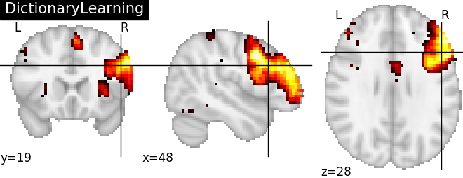
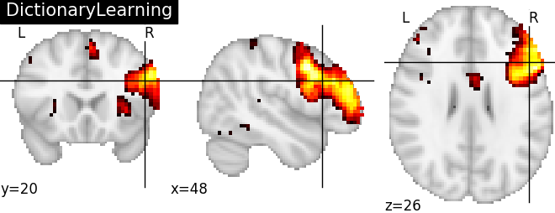

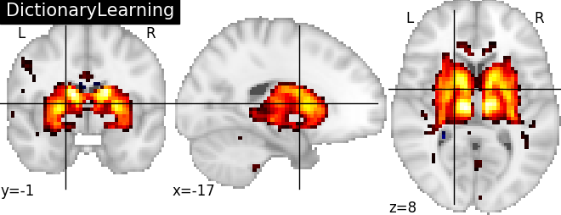
fMRI Analysis using Dictionary Learning:
Epochs: 1
Epochs: 5
Epochs: 3
Epochs: 3, method: ‘cd’

Slide 15
fMRI Analysis using Dictionary Learning:
Frontal lobe
Epochs: 5
Hypothalamus
Thalamus
Epochs: 3, method: ‘cd’
Putamen
Lateral ventricles

Slide 16
fMRI Analysis using CanICA:
Dataset: Nitrc ADHD-200 Preprocessed
Subjects: 30
Model: CaniCA
Threshold: 2 x n_voxels
n_voxels is the number of voxels, or “3D version of a pixel,” in a brain volume. A float value indicates the ratio of voxels to keep.

Slide 17
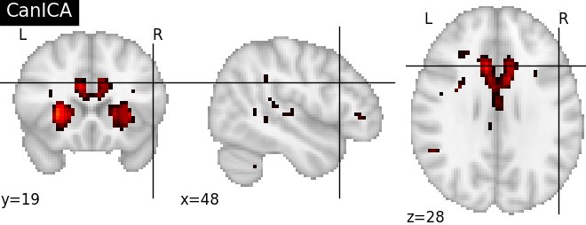
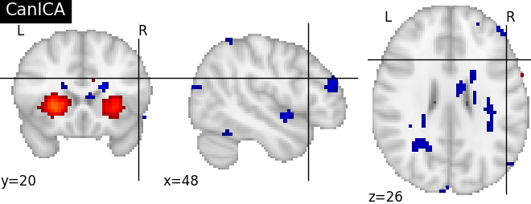
fMRI Analysis using ICA:
Voxels: 2
Voxels: 5

Slide 18
fMRI Analysis using ICA:
Voxels: 2
Hypothalamus
Putamen
Lateral ventricles
Voxels: 5

Slide 19
Brain Region Correlations with ADHD:
Hypothalamus: “The preliminary finding reported herein of lower than normal dopamine D2/D3 receptor availability in the hypothalamic region of ADHD participants is intriguing because if replicated, it could hypothetically provide a neurobiological basis for the high co-morbidity of ADHD with signs and symptoms suggestive of hypothalamic pathology” *
Thalamus: “ The thalamus likely plays a prominent role in ADHD symptomatology, based on evidence that the thalamus generates waking-state electroencephalography (EEG) rhythms along with extensive thalamic neural circuitry connections with cortical and subcortical areas.” **
Putamen: “Lesions within the dopamine-rich ventral putamen, which is part of the ventral or limbic striatum, tended to increase the risk of ADHD/Traits.” ***
Lateral ventricles: “One study reported that posterior but not anterior lateral ventricle volume was increased in children with ADHD.” ****
Sources: * https://www.ncbi.nlm.nih.gov/pmc/articles/PMC2958516/, ** https://www.ncbi.nlm.nih.gov/pubmed/25748775,
***https://www.researchgate.net/publication/11356460_Putamen_Lesions_and_the_Development_of_Attention-DeficitHyperactivity_Symptomatology, **** http://www.ajnr.org/content/28/3/543.full#xref-ref-30-1

